Slide 1
Finding the Convex Hull

Slide 2
Convex Hull
The convex hull of a set Q of points, denoted by CH(Q), is the smallest convex polygon P for which each point in Q is either on the boundary of P or in its interior.
We implicitly assume that all points in the set Q are unique and that Q contains at least two points.
Intuitively, we can think of each point in Q as being a nail sticking out from a board.
The convex hull is then the shape formed by a tight rubber band that surrounds all the nails.
The following figure shows a set of points and its convex hull.

Slide 3
p₁₀
p₆
p₉
p₇
p₅
p₁₁
p₃
p₈
p₁₂
p₄
p₂
p₁
p₀
The convex hull of {p₀, p₁, . . ., p₁₂} above is {p₀, p₁, p₃, p₁₀, p₁₂, p₀}

Slide 4
Graham’s Scan

Slide 5
GRAHAM-SCAN(Q)
1 let p₀ be the point in Q with the minimum y-coordinate,
or the leftmost such point in case of a tie
2 let ⟨p₁, p₂, . . . , p_{m}⟩ be the remaining points in Q,
sorted by polar angle in counterclockwise order around p₀
(if more than one point has the same angle, remove all but
the one that is farthest from p₀)
3 let S be an empty stack
4 PUSH(p₀, S)
5 PUSH(p₁, S)
6 PUSH(p₂, S)
7 for i = 3 to m
8 while the angle formed by points NEXT-TO-TOP(S), TOP(S),
and p_{i} makes a nonleft turn
9 POP(S)
10 PUSH(p_{i}, S)
11 return S

Slide 6
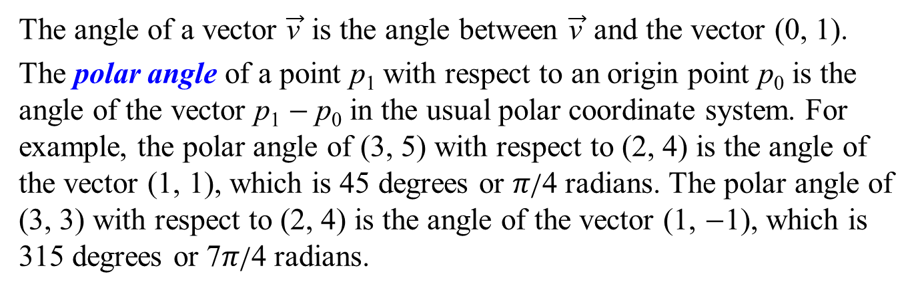
Polar angle
The angle of a vector $\vec{\text{v}}$ is the angle between $\vec{\text{v}}$ and the vector (0, 1).
The polar angle of a point p₁ with respect to an origin point p₀ is the angle of the vector p₁ − p₀ in the usual polar coordinate system. For example, the polar angle of (3, 5) with respect to (2, 4) is the angle of the vector (1, 1), which is 45 degrees or 𝜋/4 radians. The polar angle of (3, 3) with respect to (2, 4) is the angle of the vector (1, −1), which is 315 degrees or 7𝜋/4 radians.
(2, 4)
(3, 5)
(3, 3)
(2, 4)
(1, 1)
(1, −1)

Slide 7
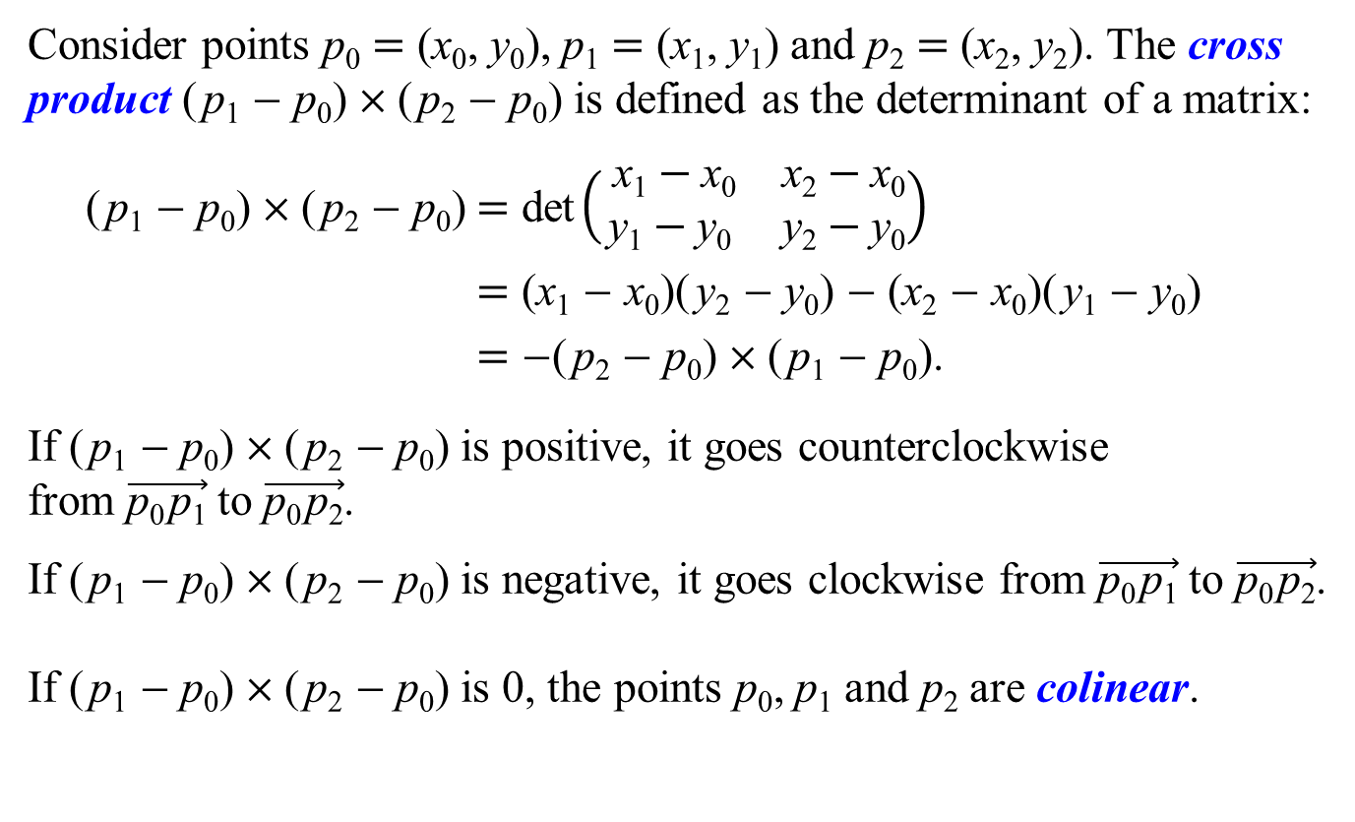
Cross Products
Consider points p₀ = (x₀, y₀), p₁ = (x₁, y₁) and p₂ = (x₂, y₂). The cross product (p₁ − p₀) × (p₂ − p₀) is defined as the determinant of a matrix:
(p₁ − p₀) × (p₂ − p₀) = det$\left(\begin{matrix} \text{x}\text{1}−\text{x}\text{0} & \text{x}\text{2}−\text{x}\text{0} \\ \text{y}\text{1}−\text{y}\text{0} & \text{y}\text{2}−\text{y}\text{0}\end{matrix}\right)$
= (x₁ − x₀)(y₂ − y₀) − (x₂ − x₀)(y₁ − y₀)
= −(p₂ − p₀) × (p₁ − p₀).
If (p₁ − p₀) × (p₂ − p₀) is positive, it goes counterclockwise from $\vec{\text{p}\text{0}\text{p}\text{1}}$ to $\vec{\text{p}\text{0}\text{p}\text{2}}$.
If (p₁ − p₀) × (p₂ − p₀) is negative, it goes clockwise from $\vec{\text{p}\text{0}\text{p}\text{1}}$ to $\vec{\text{p}\text{0}\text{p}\text{2}}$.
If (p₁ − p₀) × (p₂ − p₀) is 0, the points p₀, p₁ and p₂ are colinear.

Slide 8
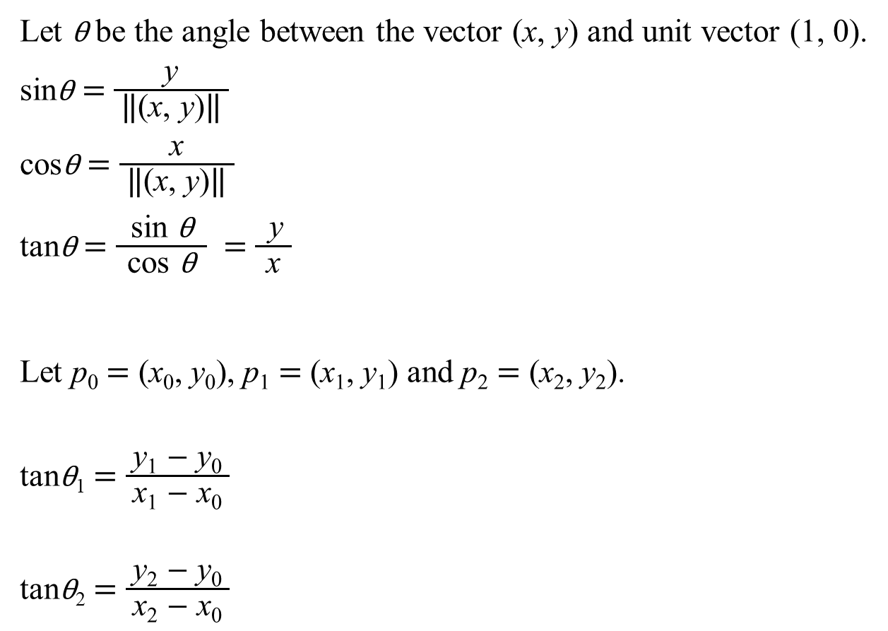
Let θ be the angle between the vector (x, y) and unit vector (1, 0).
sinθ = $\frac{\text{y}}{ \text{‖}\text{(}\text{x}\text{, }\text{y}\text{)}\text{‖} }$
cosθ = $\frac{\text{x}}{ \text{‖}\text{(}\text{x}\text{, }\text{y}\text{)}\text{‖} }$
tanθ = $\frac{ \text{sin} \text{θ} }{ \text{cos} \text{θ} }$ = $\frac{ \text{y} }{\text{x}}$
Let p₀ = (x₀, y₀), p₁ = (x₁, y₁) and p₂ = (x₂, y₂).
tanθ₁ = $\frac{ \text{y}\text{1} \text{−} \text{y}\text{0} }{\text{x}\text{1} \text{−} \text{x}\text{0}}$
tanθ₂ = $\frac{ \text{y}\text{2} \text{−} \text{y}\text{0} }{\text{x}\text{2} \text{−} \text{x}\text{0}}$
y
(x, y)
θ
(0, 0)
x
y₁
(x₁, y₁)
y₂
(x₂, y₂)
θ₁
θ₂
(x₀, y₀)
x₁
(x₀, y₀)
x₂

Slide 9
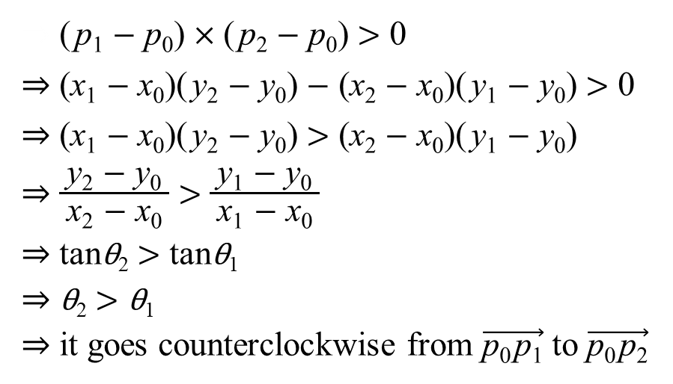
p₂
p₂
p₁
p₁
θ₂
θ₁
p₀
p₀
⇒ (p₁ − p₀) × (p₂ − p₀) > 0
⇒ (x₁ − x₀)(y₂ − y₀) − (x₂ − x₀)(y₁ − y₀) > 0
⇒ (x₁ − x₀)(y₂ − y₀) > (x₂ − x₀)(y₁ − y₀)
⇒ $\frac{ \text{y}\text{2} \text{−} \text{y}\text{0} }{\text{x}\text{2} \text{−} \text{x}\text{0}}$ > $\frac{ \text{y}\text{1} \text{−} \text{y}\text{0} }{\text{x}\text{1} \text{−} \text{x}\text{0}}$
⇒ tanθ₂ > tanθ₁
⇒ θ₂ > θ₁
⇒ it goes counterclockwise from $\vec{\text{p}\text{0}\text{p}\text{1}}$ to $\vec{\text{p}\text{0}\text{p}\text{2}}$

Slide 10
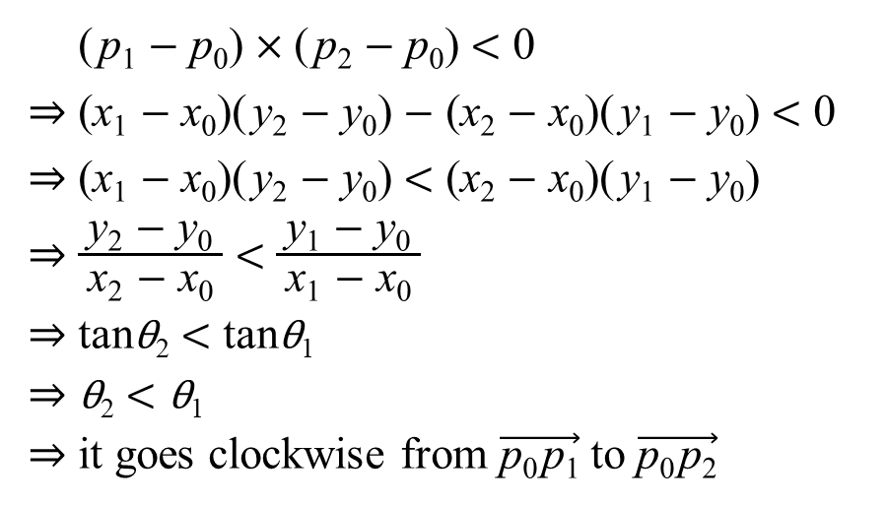
p₂
p₂
p₁
p₁
θ₂
θ₁
p₀
p₀
⇒ (p₁ − p₀) × (p₂ − p₀) < 0
⇒ (x₁ − x₀)(y₂ − y₀) − (x₂ − x₀)(y₁ − y₀) < 0
⇒ (x₁ − x₀)(y₂ − y₀) < (x₂ − x₀)(y₁ − y₀)
⇒ $\frac{ \text{y}\text{2} \text{−} \text{y}\text{0} }{\text{x}\text{2} \text{−} \text{x}\text{0}}$ < $\frac{ \text{y}\text{1} \text{−} \text{y}\text{0} }{\text{x}\text{1} \text{−} \text{x}\text{0}}$
⇒ tanθ₂ < tanθ₁
⇒ θ₂ < θ₁
⇒ it goes clockwise from $\vec{\text{p}\text{0}\text{p}\text{1}}$ to $\vec{\text{p}\text{0}\text{p}\text{2}}$

Slide 11
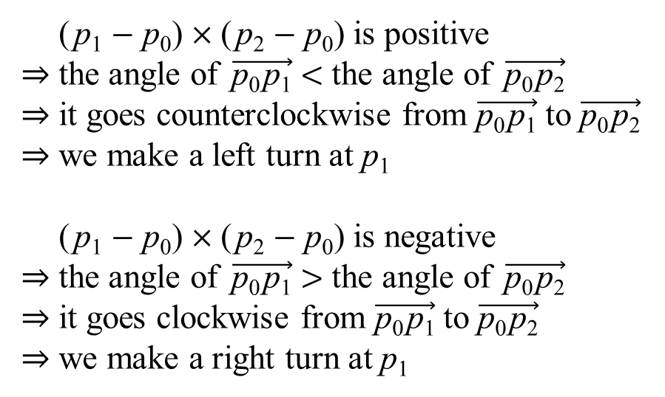
p₂
p₁
p₁
p₂
counterclockwise
clockwise
p₀
p₀
⇒ (p₁ − p₀) × (p₂ − p₀) is positive
⇒ the angle of $\vec{\text{p}\text{0}\text{p}\text{1}}$ < the angle of $\vec{\text{p}\text{0}\text{p}\text{2}}$
⇒ it goes counterclockwise from $\vec{\text{p}\text{0}\text{p}\text{1}}$ to $\vec{\text{p}\text{0}\text{p}\text{2}}$
⇒ we make a left turn at p₁
⇒ (p₁ − p₀) × (p₂ − p₀) is negative
⇒ the angle of $\vec{\text{p}\text{0}\text{p}\text{1}}$ > the angle of $\vec{\text{p}\text{0}\text{p}\text{2}}$
⇒ it goes clockwise from $\vec{\text{p}\text{0}\text{p}\text{1}}$ to $\vec{\text{p}\text{0}\text{p}\text{2}}$
⇒ we make a right turn at p₁

Slide 12
struct Point
{
int x, y;
};
vector< Point > p;
vector< Point > convexHull;

Slide 13
void GrahamScan()
{
swap( p[ 0 ], *min_element( p.begin(), p.end(), lower ) );
sort( p.begin() + 1, p.end(), angleLess );
eraseCollinear();
convexHull.push_back( p[ 0 ] );
convexHull.push_back( p[ 1 ] );
if( p.size() > 2 )
{
convexHull.push_back( p[ 2 ] );
for( size_t i = 3; i < p.size(); ++i )
{
while( !leftTurn( *( convexHull.end() - 2 ),
*( convexHull.end() - 1 ), p[ i ] ) )
convexHull.pop_back();
convexHull.push_back( p[ i ] );
}
}
convexHull.push_back( p[ 0 ] );
}

Slide 14
void GrahamScan()
{
swap( p[ 0 ], *min_element( p.begin(), p.end(), lower ) );
sort( p.begin() + 1, p.end(), angleLess );
convexHull.push_back( p[ 0 ] );
convexHull.push_back( p[ 1 ] );
for( size_t i = 2; i < p.size(); ++i )
{
while( convexHull.size() > 1 &&
!leftTurn( *( convexHull.end() - 2 ),
*( convexHull.end() - 1 ), p[ i ] ) )
convexHull.pop_back();
convexHull.push_back( p[ i ] );
}
convexHull.push_back( p[ 0 ] );
}

Slide 15
bool lower( Point p1, Point p2 )
{
return ( p1.y < p2.y ) || ( p1.y == p2.y && p1.x < p2.x );
}
int crossProduct( Point p0, Point p1, Point p2 )
{
return ( p1.x - p0.x ) * ( p2.y - p0.y ) -
( p2.x - p0.x ) * ( p1.y - p0.y );
}
bool leftTurn( Point p0, Point p1, Point p2 )
{
return crossProduct( p0, p1, p2 ) > 0;
}
int distanceSquare( Point p1, Point p2 )
{
return ( p1.x - p2.x ) * ( p1.x - p2.x ) +
( p1.y - p2.y ) * ( p1.y - p2.y );
}

Slide 16
bool shorter( Point p0, Point p1, Point p2 )
{
return distanceSquare( p0, p1 ) < distanceSquare( p0, p2 );
}
bool angleLess( Point p1, Point p2 )
{
int c = crossProduct( p[ 0 ], p1, p2 );
return c > 0 || ( c == 0 && shorter( p[ 0 ], p1, p2 ) );
}
void eraseCollinear()
{
vector< Point >::iterator it = p.begin();
while( it < p.end() - 2 )
if( crossProduct( p[ 0 ], *( it + 1 ), *( it + 2 ) ) == 0 )
if( shorter( p[ 0 ], *( it + 1 ), *( it + 2 ) ) )
p.erase( it + 1 );
else
p.erase( it + 2 );
else
++it;
}

Slide 17
Ronald L. Graham. An efficient algorithm for determining the convex hull of a finite planar set. Information Processing Letters, 1(4):132–133, 1972.

Slide 18
Line 1 chooses point p₀ as the point with the lowest y-coordinate, picking the leftmost such point in case of a tie.
Since there is no point in Q that is below p₀ and any other points with the same y-coordinate are to its right, p₀ must be a vertex of CH(Q).
Line 2 sorts the remaining points of Q by polar angle relative to p₀.
If two or more points have the same polar angle relative to p₀, all but the farthest such point are convex combinations of p₀ and the farthest point, and so we remove them entirely from consideration.
We let m denote the number of points other than p₀ that remain.
The polar angle, measured in radians, of each point in Q relative to p₀ is in the half-open interval [0, 𝜋).
Since the points are sorted according to polar angles, they are sorted in counterclockwise order relative to p₀.
We designate this sorted sequence of points by ⟨p₁, p₂, . . . , p_{m}⟩.
Note that points p₁ and p_{m} are vertices of CH(Q).

Slide 19
for( size_t i = 3; i < p.size(); ++i )
{
while( !leftTurn( *( convexHull.end() - 2 ),
*( convexHull.end() - 1 ), p[ i ] ) )
convexHull.pop_back();
convexHull.push_back( p[ i ] );
}
p₁₀
0 | 1 | 2 | 3 | 4 | 5 | 6
convexHull
p₉
p₆
p₇
p₁₁
p₈
p₅
p₃
p₁₂
p₄
p₂
p₁
p₀

Slide 20
for( size_t i = 3; i < p.size(); ++i )
{
while( !leftTurn( *( convexHull.end() - 2 ),
*( convexHull.end() - 1 ), p[ i ] ) )
convexHull.pop_back();
convexHull.push_back( p[ i ] );
}
p₁₀
0 | 1 | 2 | 3 | 4 | 5 | 6
p₀ | p₁ | p₂
convexHull
p₆
p₉
p₇
p₅
p₁₁
p₃
p₈
p₁₂
p₄
p₂
p₁
p₀

Slide 21
for( size_t i = 3; i < p.size(); ++i )
{
while( !leftTurn( *( convexHull.end() - 2 ),
*( convexHull.end() - 1 ), p[ i ] ) )
convexHull.pop_back();
convexHull.push_back( p[ i ] );
}
p₁₀
0 | 1 | 2 | 3 | 4 | 5 | 6
p₀ | p₁
convexHull
p₆
p₉
p₇
p₅
p₁₁
p₃
p₈
p₁₂
p₄
p₂
p₁
p₀

Slide 22
for( size_t i = 3; i < p.size(); ++i )
{
while( !leftTurn( *( convexHull.end() - 2 ),
*( convexHull.end() - 1 ), p[ i ] ) )
convexHull.pop_back();
convexHull.push_back( p[ i ] );
}
p₁₀
0 | 1 | 2 | 3 | 4 | 5 | 6
p₀ | p₁ | p₃
convexHull
p₆
p₉
p₇
p₅
p₁₁
p₃
p₈
p₁₂
p₄
p₂
p₁
p₀

Slide 23
for( size_t i = 3; i < p.size(); ++i )
{
while( !leftTurn( *( convexHull.end() - 2 ),
*( convexHull.end() - 1 ), p[ i ] ) )
convexHull.pop_back();
convexHull.push_back( p[ i ] );
}
p₁₀
0 | 1 | 2 | 3 | 4 | 5 | 6
p₀ | p₁ | p₃ | p₄
convexHull
p₆
p₉
p₇
p₅
p₁₁
p₃
p₈
p₁₂
p₄
p₂
p₁
p₀

Slide 24
for( size_t i = 3; i < p.size(); ++i )
{
while( !leftTurn( *( convexHull.end() - 2 ),
*( convexHull.end() - 1 ), p[ i ] ) )
convexHull.pop_back();
convexHull.push_back( p[ i ] );
}
p₁₀
0 | 1 | 2 | 3 | 4 | 5 | 6
p₀ | p₁ | p₃
convexHull
p₆
p₉
p₇
p₅
p₁₁
p₃
p₈
p₁₂
p₄
p₂
p₁
p₀

Slide 25
for( size_t i = 3; i < p.size(); ++i )
{
while( !leftTurn( *( convexHull.end() - 2 ),
*( convexHull.end() - 1 ), p[ i ] ) )
convexHull.pop_back();
convexHull.push_back( p[ i ] );
}
p₁₀
0 | 1 | 2 | 3 | 4 | 5 | 6
p₀ | p₁ | p₃ | p₅
convexHull
p₆
p₉
p₇
p₅
p₁₁
p₃
p₈
p₁₂
p₄
p₂
p₁
p₀

Slide 26
for( size_t i = 3; i < p.size(); ++i )
{
while( !leftTurn( *( convexHull.end() - 2 ),
*( convexHull.end() - 1 ), p[ i ] ) )
convexHull.pop_back();
convexHull.push_back( p[ i ] );
}
p₁₀
0 | 1 | 2 | 3 | 4 | 5 | 6
p₀ | p₁ | p₃ | p₅ | p₆
convexHull
p₆
p₉
p₇
p₅
p₁₁
p₃
p₈
p₁₂
p₄
p₂
p₁
p₀

Slide 27
for( size_t i = 3; i < p.size(); ++i )
{
while( !leftTurn( *( convexHull.end() - 2 ),
*( convexHull.end() - 1 ), p[ i ] ) )
convexHull.pop_back();
convexHull.push_back( p[ i ] );
}
p₁₀
0 | 1 | 2 | 3 | 4 | 5 | 6
p₀ | p₁ | p₃ | p₅ | p₆ | p₇
convexHull
p₆
p₉
p₇
p₅
p₁₁
p₃
p₈
p₁₂
p₄
p₂
p₁
p₀

Slide 28
for( size_t i = 3; i < p.size(); ++i )
{
while( !leftTurn( *( convexHull.end() - 2 ),
*( convexHull.end() - 1 ), p[ i ] ) )
convexHull.pop_back();
convexHull.push_back( p[ i ] );
}
p₁₀
0 | 1 | 2 | 3 | 4 | 5 | 6
p₀ | p₁ | p₃ | p₅ | p₆ | p₇ | p₈
convexHull
p₆
p₉
p₇
p₅
p₁₁
p₃
p₈
p₁₂
p₄
p₂
p₁
p₀

Slide 29
for( size_t i = 3; i < p.size(); ++i )
{
while( !leftTurn( *( convexHull.end() - 2 ),
*( convexHull.end() - 1 ), p[ i ] ) )
convexHull.pop_back();
convexHull.push_back( p[ i ] );
}
p₁₀
0 | 1 | 2 | 3 | 4 | 5 | 6
p₀ | p₁ | p₃ | p₅ | p₆ | p₇
convexHull
p₆
p₉
p₇
p₅
p₁₁
p₃
p₈
p₁₂
p₄
p₂
p₁
p₀

Slide 30
for( size_t i = 3; i < p.size(); ++i )
{
while( !leftTurn( *( convexHull.end() - 2 ),
*( convexHull.end() - 1 ), p[ i ] ) )
convexHull.pop_back();
convexHull.push_back( p[ i ] );
}
p₁₀
0 | 1 | 2 | 3 | 4 | 5 | 6
p₀ | p₁ | p₃ | p₅ | p₆
convexHull
p₆
p₉
p₇
p₅
p₁₁
p₃
p₈
p₁₂
p₄
p₂
p₁
p₀

Slide 31
for( size_t i = 3; i < p.size(); ++i )
{
while( !leftTurn( *( convexHull.end() - 2 ),
*( convexHull.end() - 1 ), p[ i ] ) )
convexHull.pop_back();
convexHull.push_back( p[ i ] );
}
p₁₀
0 | 1 | 2 | 3 | 4 | 5 | 6
p₀ | p₁ | p₃ | p₅ | p₆ | p₉
convexHull
p₆
p₉
p₇
p₅
p₁₁
p₃
p₈
p₁₂
p₄
p₂
p₁
p₀

Slide 32
for( size_t i = 3; i < p.size(); ++i )
{
while( !leftTurn( *( convexHull.end() - 2 ),
*( convexHull.end() - 1 ), p[ i ] ) )
convexHull.pop_back();
convexHull.push_back( p[ i ] );
}
p₁₀
0 | 1 | 2 | 3 | 4 | 5 | 6
p₀ | p₁ | p₃ | p₅ | p₆
convexHull
p₉
p₆
p₇
p₅
p₁₁
p₃
p₈
p₁₂
p₄
p₂
p₁
p₀

Slide 33
for( size_t i = 3; i < p.size(); ++i )
{
while( !leftTurn( *( convexHull.end() - 2 ),
*( convexHull.end() - 1 ), p[ i ] ) )
convexHull.pop_back();
convexHull.push_back( p[ i ] );
}
p₁₀
0 | 1 | 2 | 3 | 4 | 5 | 6
p₀ | p₁ | p₃ | p₅
convexHull
p₉
p₆
p₇
p₅
p₁₁
p₃
p₈
p₁₂
p₄
p₂
p₁
p₀

Slide 34
for( size_t i = 3; i < p.size(); ++i )
{
while( !leftTurn( *( convexHull.end() - 2 ),
*( convexHull.end() - 1 ), p[ i ] ) )
convexHull.pop_back();
convexHull.push_back( p[ i ] );
}
p₁₀
0 | 1 | 2 | 3 | 4 | 5 | 6
p₀ | p₁ | p₃
convexHull
p₉
p₆
p₇
p₅
p₁₁
p₃
p₈
p₁₂
p₄
p₂
p₁
p₀

Slide 35
for( size_t i = 3; i < p.size(); ++i )
{
while( !leftTurn( *( convexHull.end() - 2 ),
*( convexHull.end() - 1 ), p[ i ] ) )
convexHull.pop_back();
convexHull.push_back( p[ i ] );
}
p₁₀
0 | 1 | 2 | 3 | 4 | 5 | 6
p₀ | p₁ | p₃ | p₁₀
convexHull
p₉
p₆
p₇
p₅
p₁₁
p₃
p₈
p₁₂
p₄
p₂
p₁
p₀

Slide 36
for( size_t i = 3; i < p.size(); ++i )
{
while( !leftTurn( *( convexHull.end() - 2 ),
*( convexHull.end() - 1 ), p[ i ] ) )
convexHull.pop_back();
convexHull.push_back( p[ i ] );
}
p₁₀
0 | 1 | 2 | 3 | 4 | 5 | 6
p₀ | p₁ | p₃ | p₁₀ | p₁₁
convexHull
p₉
p₆
p₇
p₅
p₁₁
p₃
p₈
p₁₂
p₄
p₂
p₁
p₀

Slide 37
for( size_t i = 3; i < p.size(); ++i )
{
while( !leftTurn( *( convexHull.end() - 2 ),
*( convexHull.end() - 1 ), p[ i ] ) )
convexHull.pop_back();
convexHull.push_back( p[ i ] );
}
p₁₀
0 | 1 | 2 | 3 | 4 | 5 | 6
p₀ | p₁ | p₃ | p₁₀
convexHull
p₉
p₆
p₇
p₅
p₁₁
p₃
p₈
p₁₂
p₄
p₂
p₁
p₀

Slide 38
for( size_t i = 3; i < p.size(); ++i )
{
while( !leftTurn( *( convexHull.end() - 2 ),
*( convexHull.end() - 1 ), p[ i ] ) )
convexHull.pop_back();
convexHull.push_back( p[ i ] );
}
p₁₀
0 | 1 | 2 | 3 | 4 | 5 | 6
p₀ | p₁ | p₃ | p₁₀ | p₁₂
convexHull
p₉
p₆
p₇
p₅
p₁₁
p₃
p₈
p₁₂
p₄
p₂
p₁
p₀

Slide 39
for( size_t i = 3; i < p.size(); ++i )
{
while( !leftTurn( *( convexHull.end() - 2 ),
*( convexHull.end() - 1 ), p[ i ] ) )
convexHull.pop_back();
convexHull.push_back( p[ i ] );
}
p₁₀
0 | 1 | 2 | 3 | 4 | 5 | 6
p₀ | p₁ | p₃ | p₁₀ | p₁₂ | p₀
convexHull
p₉
p₆
p₇
p₅
p₁₁
p₃
p₈
p₁₂
p₄
p₂
p₁
p₀

Slide 40
void GrahamScan()
{
swap( p[ 0 ], *min_element( p.begin(), p.end(), lower ) );
sort( p.begin() + 1, p.end(), angleLess );
eraseCollinear();
convexHull.push_back( p[ 0 ] );
convexHull.push_back( p[ 1 ] );
if( p.size() > 2 )
{
convexHull.push_back( p[ 2 ] );
for( size_t i = 3; i < p.size(); ++i )
{
while( !leftTurn( *( convexHull.end() - 2 ),
*( convexHull.end() - 1 ), p[ i ] ) )
convexHull.pop_back();
convexHull.push_back( p[ i ] );
}
}
convexHull.push_back( p[ 0 ] );
}

Slide 41
The time complexity of GrahamScan
We now show that the time complexity of GrahamScan is O(nlgn), where n = p.size() before the execution of eraseCollinear.
min_element takes Θ(n) time.
sort takes O(nlgn) time.
eraseCollinear takes Θ(n) time.
For i = 0, 1, . . ., m, we push_back each point p_{i} into convexHull exactly once, where m = p.size() after the execution of eraseCollinear.
We can pop_back at most the number of items that we push_back.
At most m +1 pop_back operations are performed in total.
Each iteration of the while loop performs one pop_back, and so there are at most m +1 iterations of the while loop altogether.
The total time taken by the while loop is O(n).
Thus, the time complexity of GrahamScan is O(nlgn).

